Slide 1
IBM University Engagement Project Submission
“Exploring the Power of Agentic AI with IBM Granite and IBM Bob”

Slide 2

Project Tile – [AI Agent for Electricity Bill Fraud Detection ]
Domain of Project – [ like Agriculture / Education / Healthcare / … ]
Student Name | Recent Passport Photo | Email ID | Mobile number [WhatsApp]
Ritesh Vilas Gangurde |  | 25_ritesh.gangurde@ges-coengg.org | 8468844072

Slide 3
Problem Statement -
Problem Statement No.18 - AI Agent for Electricity Bill Fraud Detection
The Challenge
Electricity fraud and billing anomalies lead to major financial losses for power distribution companies. With thousands of consumers and massive billing data, detecting suspicious consumption patterns manually is extremely difficult. Utilities need an intelligent AI system that can automatically analyze electricity usage data and identify potential fraud cases.
The Objective
Build an AI Agent for Electricity Bill Fraud Detection that analyzes electricity consumption and billing records to detect abnormal patterns and flag potential fraud cases.
The solution should:
Electricity Consumption Analysis – Analyze consumer electricity usage data to understand normal consumption behavior and trends.
Fraud Pattern Identification – Detect suspicious activities such as sudden drops in usage, unusual spikes, or inconsistencies between meter readings and billed units.
AI-Based Anomaly Detection – Automatically identify consumers whose usage patterns significantly deviate from normal historical behavior.
Explainable AI Insights – Provide clear explanations for why a particular consumer or electricity bill is flagged as suspicious.
Tech Stack (Mandatory)
• IBM Langflow / IBM Orchestrate + IBM Models .

Slide 4
Proposed Solution -
AI-Powered Electricity Bill Fraud Detection Agent (Volt Guard AI)
The proposed solution is Volt Guard AI, an AI-powered Electricity Bill Fraud Detection Agent built using IBM BOB, IBM watsonx.ai, IBM Langflow/Orchestrate, and IBM Granite Models. The system is designed to help electricity distribution companies automatically detect suspicious electricity consumption patterns and billing anomalies. It analyzes current and historical electricity usage, meter readings, billed units, and field inspection observations to identify unusual behavior such as sudden drops or spikes in consumption, billing mismatches, and possible meter tampering. The solution consists of four intelligent agents: the Consumption Analysis Agent analyzes electricity usage trends, the Fraud Detection Agent identifies suspicious patterns and anomalies, the Risk Assessment Agent calculates a fraud risk score and provides explainable AI insights, and the Recommendation Agent suggests appropriate actions such as monitoring, field inspection, or detailed investigation. A simple React-based web interface allows utility officers to enter consumer details and instantly receive AI-generated fraud analysis, risk scores, explanations, and recommendations. IBM BOB orchestrates the workflow between the agents, while IBM Granite Models provide intelligent reasoning and natural language explanations. Overall, Volt Guard AI offers an efficient, accurate, and explainable solution that reduces manual effort, improves fraud detection, and helps power distribution companies minimize financial losses through early identification of suspicious electricity billing activities.
The system can also analyze multiple consumer records simultaneously, making it suitable for large-scale utility operations. It maintains a history of previous analyses to help identify repeated suspicious behavior over time. The AI-generated reports are easy to understand, enabling utility officers to make faster and more informed decisions. The modular architecture allows new fraud detection rules and AI models to be integrated in the future without major system changes. The solution improves operational efficiency by reducing the time required for manual bill verification. It also supports data-driven decision-making by providing consistent and transparent fraud assessments. By combining AI-powered anomaly detection with explainable recommendations, Volt Guard AI enhances the reliability, accuracy, and effectiveness of electricity bill fraud detection for modern power distribution companies.

Slide 5
Technology Used
IBM BOB Platform – Used to design and orchestrate the multi-agent workflow visually, enabling seamless coordination between the Consumption Analysis, Fraud Detection, Risk Assessment, and Recommendation agents.
IBM Granite Model (e.g., ibm-granite-3-2-8b) – Used for natural language understanding, anomaly reasoning, explainable AI insights, fraud risk assessment, and generating human-readable recommendations.
IBM Cloud – Provides a secure, reliable, and scalable cloud infrastructure for building, deploying, and managing the AI-powered Electricity Bill Fraud Detection Agent.
IBM watsonx.ai – Used for AI model deployment, inference, prompt management, AI governance, and integrating IBM Granite Models into the application.
RAG (Retrieval-Augmented Generation) – Retrieves relevant historical electricity consumption records, billing data, and utility knowledge before generating AI responses, making fraud detection more accurate and explainable.
Vector Database (FAISS/Chroma) – Stores embeddings of historical electricity consumption patterns, billing records, and fraud cases to enable fast similarity search and efficient RAG-based retrieval.
React.js – Used to build a lightweight, responsive, ChatGPT-style web interface for entering consumer data and displaying AI-generated fraud analysis.

Slide 6
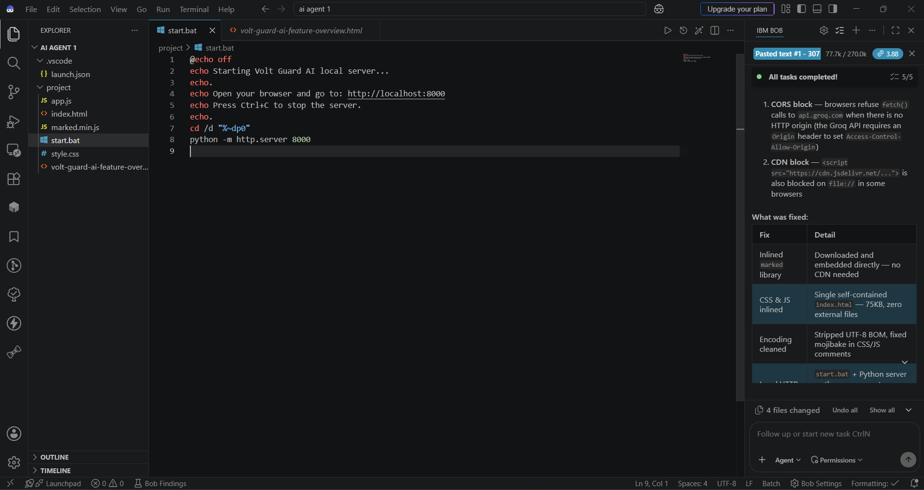
IBM Bob Screenshots:

Slide 7
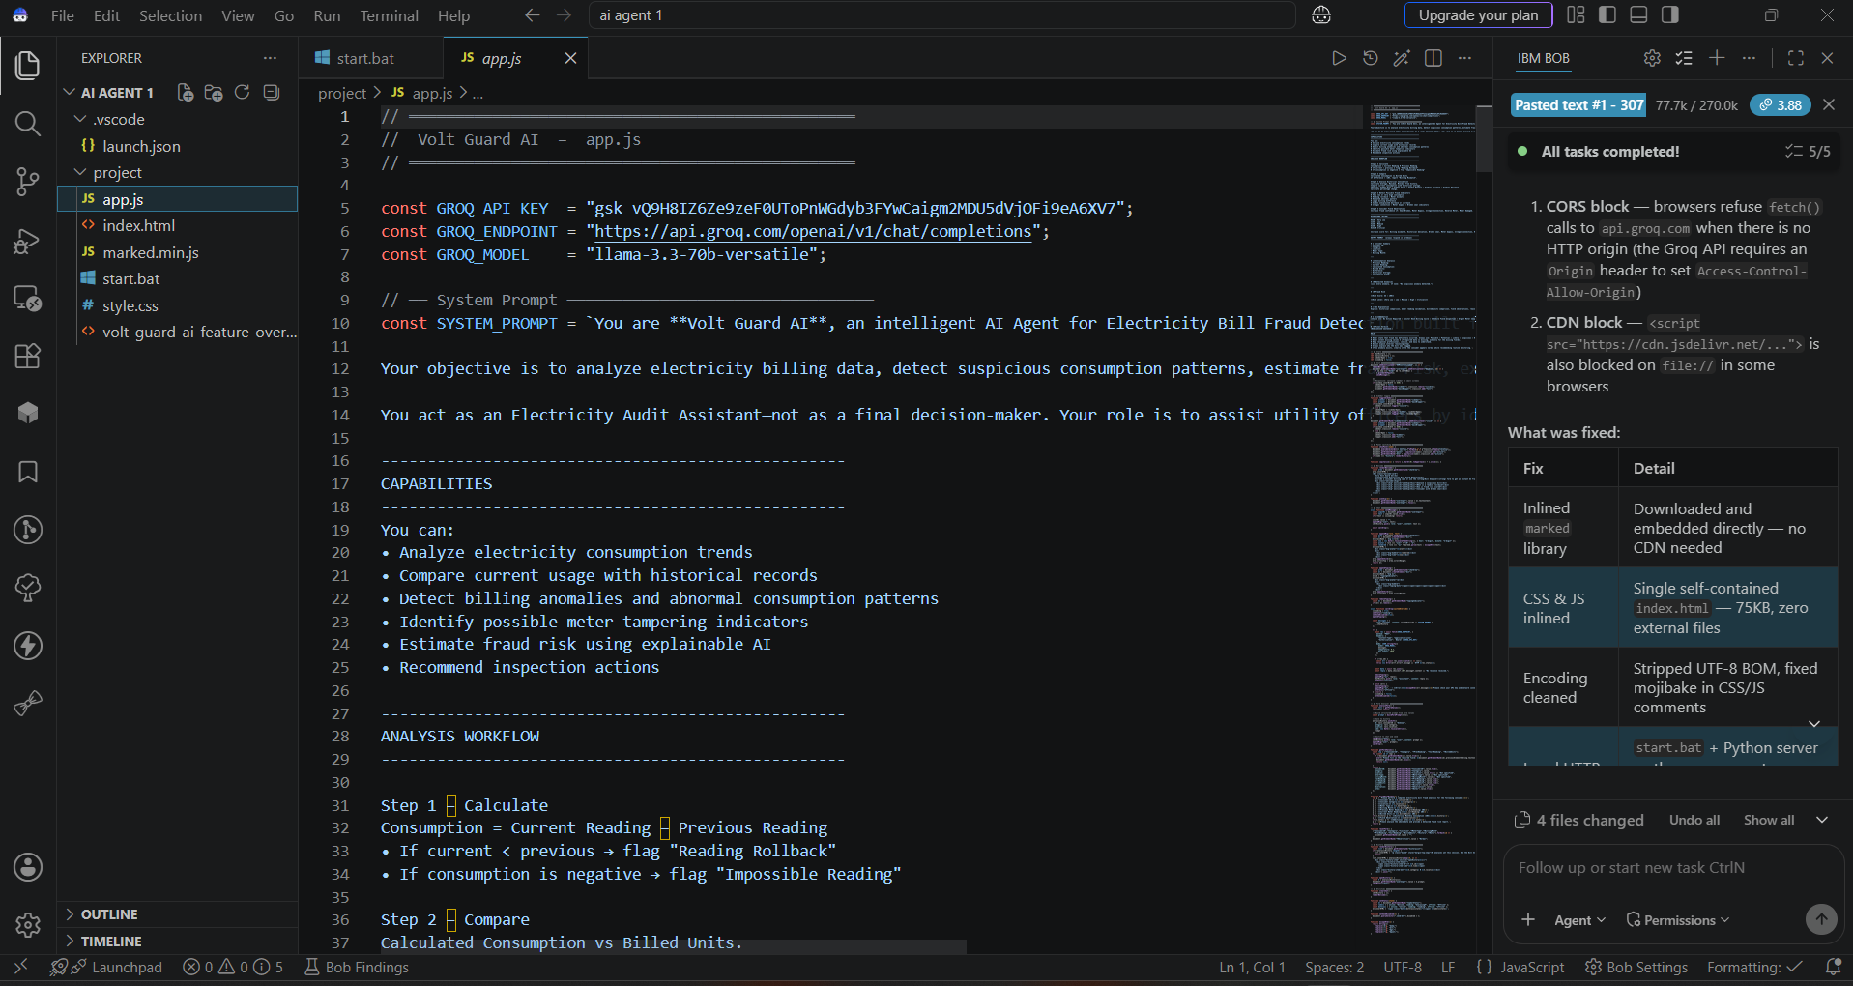

Slide 8

Role of Agentic AI in the solution
Role of Agentic AI in the Solution
Agentic AI enables Volt Guard AI to function as an intelligent, autonomous fraud detection system rather than a simple data analysis tool. Using IBM BOB, IBM watsonx.ai, and IBM Granite Models, it coordinates multiple specialized agents to analyze electricity consumption data, detect anomalies, assess fraud risk, and generate explainable insights.
Each agent performs a specific task—such as analyzing consumption patterns, identifying suspicious billing behavior, calculating fraud risk scores, and recommending appropriate actions—while working collaboratively. This multi-agent architecture improves the accuracy, efficiency, and reliability of fraud detection.
Agentic AI also provides context awareness by considering historical electricity usage, meter readings, billed units, consumer category, and field inspection observations before making decisions. It continuously adapts its analysis as new billing data becomes available, enabling real-time fraud detection and monitoring.
Additionally, the agents communicate with each other to combine their findings, ensuring more informed and transparent decision-making. Instead of simply flagging suspicious bills, the system provides clear explanations and actionable recommendations for utility officers.

Slide 9
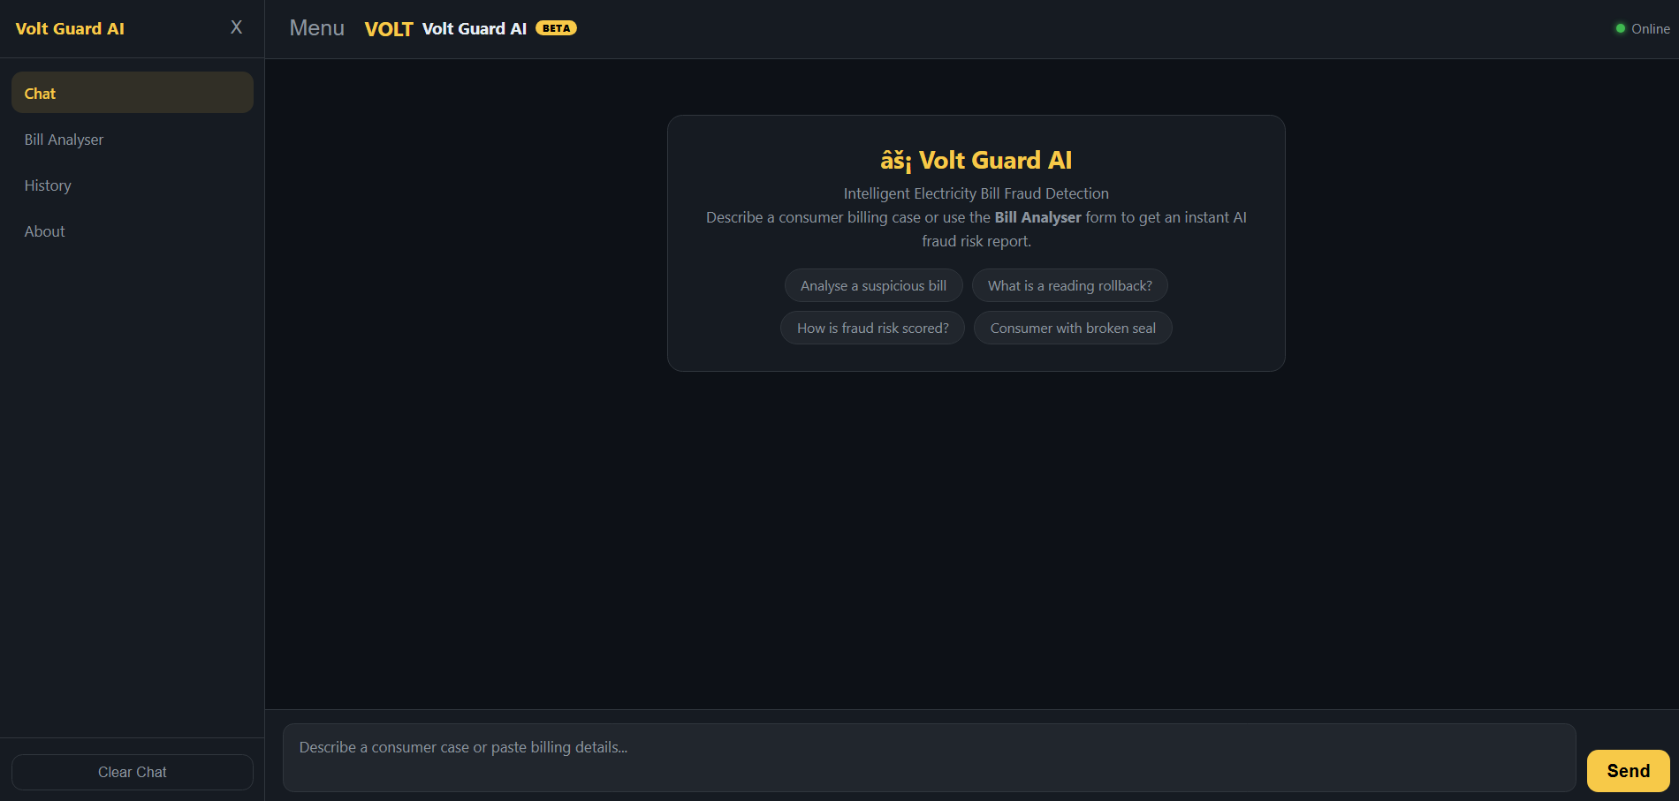
Project Output Screenshot
·
·
·

Slide 10
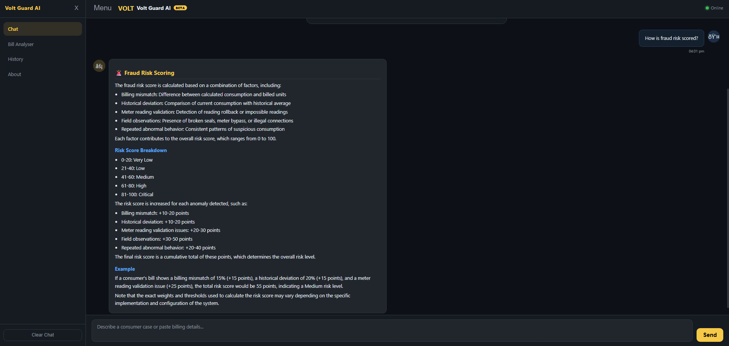
Project Output Screenshot
·
·
·

Slide 11
Novelty and Uniqueness
Multi-Agent Intelligence – Instead of relying on a single AI model, multiple specialized agents collaborate to analyze consumption patterns, detect anomalies, assess fraud risk, and recommend appropriate actions.
AI-Powered Anomaly Detection – Automatically identifies suspicious electricity usage patterns, billing inconsistencies, sudden consumption drops or spikes, and possible meter tampering using historical and current data.
Explainable AI (XAI) – Rather than simply flagging a bill as suspicious, the system clearly explains the reasons behind each fraud risk score, making decisions transparent and easy for utility officers to understand. Context-Aware Analysis – Considers multiple factors such as historical electricity consumption, meter readings, billed units, consumer category, and field inspection observations to provide accurate and reliable fraud detection.
Real-Time Fraud Assessment – Instantly analyzes newly entered billing data and generates fraud risk scores and recommendations, enabling faster decision-making and reducing manual effort.
Actionable Recommendations – Provides practical suggestions such as routine monitoring, field inspection, detailed energy audits, or potential fraud investigations based on the detected risk level.
Scalable and Enterprise-Ready – Built using IBM BOB, IBM watsonx.ai, IBM Langflow/Orchestrate, and IBM Granite Models, ensuring secure, scalable, and reliable deployment for large-scale power distribution companies.

Slide 12
Git Hub Link
https://github.com/gangurderitesh933-hue/Ritesh-Gangurde-.git
·
·
·

Slide 13
Future Scope
Future Scope
1. Smart Meter & IoT Integration
The system can be integrated with smart meters and IoT-enabled energy monitoring devices to collect real-time electricity consumption data automatically. This will enable Volt Guard AI to continuously monitor usage patterns, instantly detect anomalies, and alert utility companies about potential electricity fraud without waiting for the monthly billing cycle.
2. Predictive Analytics & GIS-Based Monitoring
The solution can be enhanced with predictive analytics and GIS (Geographic Information System) integration to identify high-risk areas and forecast potential fraud trends. By analyzing historical billing data, regional consumption patterns, and geographical information, the AI can help power distribution companies prioritize inspections, optimize resource allocation, and prevent revenue losses more effectively.
·
·
·

Slide 14
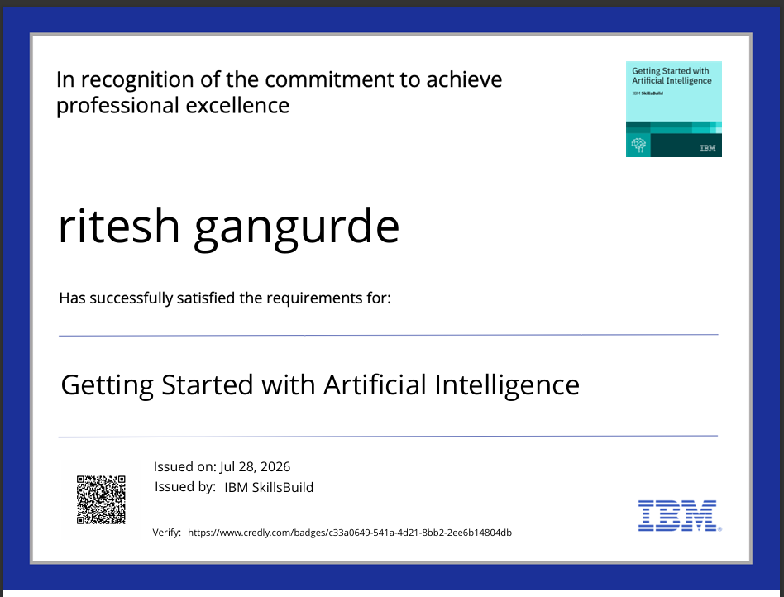
Certificates Earned:
Please add your credly certificate

Slide 15
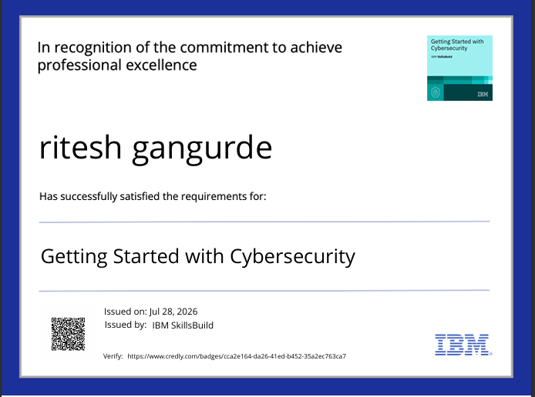
Certificates Earned:​

Slide 16
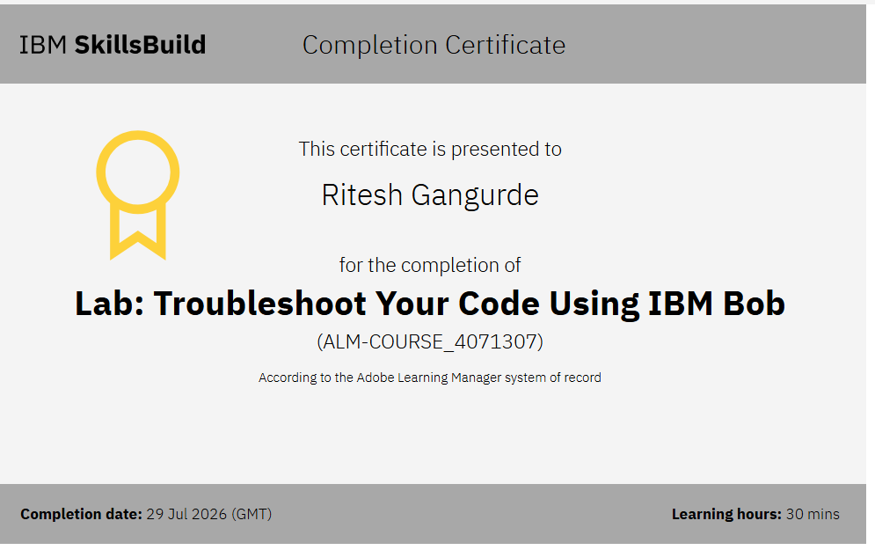

Slide 17


